Slide 1
JNI2AKI implementation
Canadian R&D Institute CBG Team
Tony Zhu t84149270

Slide 2
Scenario- directly call
java
d.ts
package com.example.jnidemo; public class Hello { public native int add(int a, int b);
public native String sayHello(); }
export const add: (num1: number, num2: number) => number
export const sayHello: () => string
w/ parameters
w/o parameters
JNI
aki
extern "C“ JNIEXPORT jint JNICALL
Java_com_example_jnidemo_Hello_add(JNIEnv *env, jobject thiz, jint a, jint b) {
return a + b;
}
extern "C“ JNIEXPORT jstring JNICALL
Java_com_example_jnidemo_Hello_sayHello(JNIEnv *env, jobject thiz) {
std::string hello = “Thank you!";
return env->NewStringUTF(hello.c_str());
}
int add(int a, int b) {
return a + b;
} std::string sayHello() {
return "Thank you!";
}
JSBIND_GLOBAL() { JSBIND_FUNCTION(add);
JSBIND_FUNCTION(sayHello); } JSBIND_ADDON(entry)

Slide 3
Scenario - Callback 1
java
d.ts
ets
package com.example.jnidemo; public class Hello { public native String sayHello();
public String getName(){return "Alice";} }
export const sayHello: () => string
function getName() : string { return "Alice"; } // @ts-ignore testAki.JSBind.bindFunction("getName",getName);
aki
JNI
std::string sayHello() { auto method = aki::JSBind::GetJSFunction("getName"); auto str = method->Invoke<char *>(); return (std::string)"Hi, "+ str + ". This is Bob"; }
JSBIND_GLOBAL() { JSBIND_FUNCTION(sayHello); } JSBIND_ADDON(entry)
extern "C" JNIEXPORT jstring JNICALL Java_com_example_jnidemo_Hello_sayHello(JNIEnv *env, jobject thiz) { jclass jc = env->GetObjectClass(thiz); jmethodID jmid = env->GetMethodID(jc,"getName","()Ljava/lang/String;"); jstring jstr = (jstring)env->CallObjectMethod(thiz,jmid); std::string nstr= env->GetStringUTFChars(jstr, nullptr); std::string hello = (std::string)"Hi, " + nstr.c_str()+ (std::string)". This is Bob"; return env->NewStringUTF(hello.c_str()); }
reflection
当前函数（同一个线程）里面回调，直接用findClass或者GetObjectClass
ets,aki协同完成反射功能

Slide 4
Scenario - Callback2
java
package com.example.jnidemo; public class Hello {
public void onSayHelloBack(String response){ Log.i("JNI2AKI-JAVA",response); } public native void sayHello();
}
dts/ets
JNI
其他线程里面回调到java层，通过NewGlobalRef，保存全局变量
JavaVM *g_VM; jobject g_obj; void * sayHelloThread(void *) {
JNIEnv *env;
int getEnvStat = g_VM->GetEnv( (void **) &env,JNI_VERSION_1_6);
g_VM->AttachCurrentThread(&env, NULL); jclass jc = env->GetObjectClass(g_obj); jmethodID jmid = env->GetMethodID(jc, "onSayHelloBack", "(Ljava/lang/String;)V"); jstring bob = env->NewStringUTF("Hi,my name is Bob"); env->CallVoidMethod(g_obj, jmid,bob);
g_VM->DetachCurrentThread(); return NULL; }
extern "C“ JNIEXPORT jstring JNICALL Java_com_example_jnidemo_Hello_sayHello(JNIEnv *env, jobject thiz) {
pthread_t thread; env->GetJavaVM(&g_VM); g_obj = env->NewGlobalRef(thiz); pthread_create(&thread,NULL, sayHelloThread,NULL); return
}
aki
JVM and multithread involved
Code not available yet

Slide 5
Scenario - Callback-Listener
java
package com.example.jnidemo; public class Hello {
interface ISayHelloListener{ public void onSayHelloBack(String response); } public native void sayHelloCallback(ISayHelloListener sayHelloListener);
}
…
sayHelloCallback(new ISayHelloListener() { @Override public void onSayHelloBack(String response) { Log.i("JNI2AKI-JAVA",response); } });
…
dts/ets
JNI
通过把接口jobject 传递到c层下面去，然后在c层里面进行回调
JavaVM *g_VM; jobject g_obj; void * sayHelloCbImpl(void *p) { JNIEnv *env; int getEnvStat = g_VM->GetEnv( (void **) &env,JNI_VERSION_1_6); g_VM->AttachCurrentThread(&env, NULL) != 0) { jobject jcallback = (jobject)p; jclass jc = env->GetObjectClass(jcallback); jmethodID jmid = env->GetMethodID(jc, "onSayHelloBack", "(Ljava/lang/String;)V"); jstring bob = env->NewStringUTF("Hi,my name is Bob"); env->CallVoidMethod(jcallback, jmid,bob); g_VM->DetachCurrentThread(); env = NULL; return NULL; }
extern "C“ JNIEXPORT jstring JNICALL Java_com_example_jnidemo_Hello_sayHello(JNIEnv *env, jobject thiz) {
pthread_t thread; env->GetJavaVM(&g_VM); jobject callback = env->NewGlobalRef(jcb); pthread_create(&thread,NULL, sayHelloCbImpl,callback); return ;
}
aki
JVM and multithread involved
Code not available yet

Slide 6
Scenario – reflection
java
d.ts
ets
function password_jni2aki() : string { return “oldpassword"; } // @ts-ignore testAki.JSBind.bindFunction("password_jni2aki
", password_jni2aki);
…
password = testAki.changePassword();
package com.example.jnidemo; public class Hello {
public String password = "oldpassword"; public native void changePassword(); }
export const changePassword: () => string
JNI
aki
extern "C" JNIEXPORT void JNICALL Java_com_example_jnidemo_Hello_changePassword(JNIEnv *env, jobject thiz) { jclass jc = env->GetObjectClass(thiz); jfieldID jf = env->GetFieldID(jc, "password", "Ljava/lang/String;"); jstring value = env->NewStringUTF("newpassword"); env->SetObjectField(thiz, jf, value); }
void changePassword() { auto method = aki::JSBind::GetJSFunction("password_jni2aki"); auto newPass = method->Invoke<char *>(); return newPass;
}
JSBIND_GLOBAL() { JSBIND_FUNCTION(changePassword);
} JSBIND_ADDON(entry)
因为aki不支持反射，并且暂时不支持绑定field，本方法为tricky实现（暂未考虑如何转换）

Slide 7
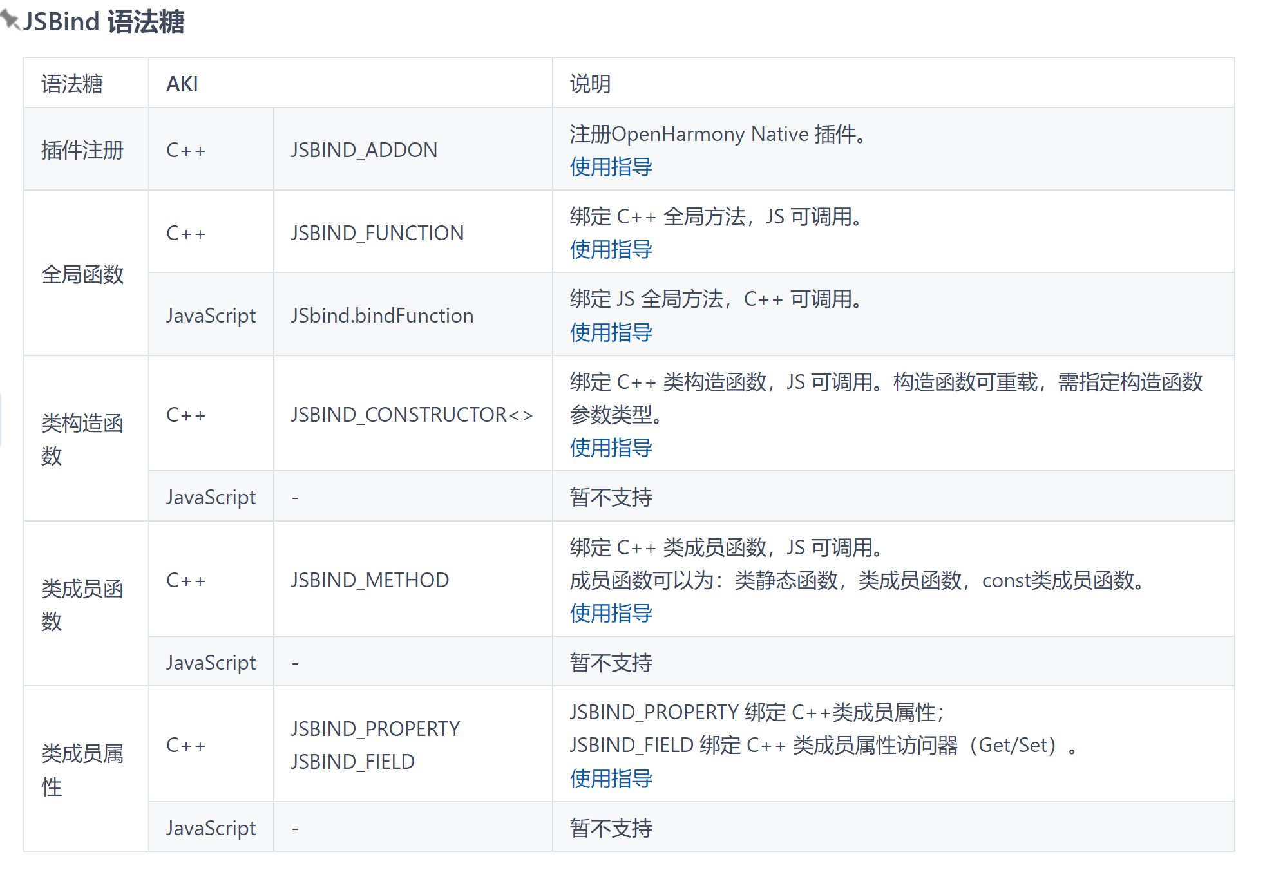
未来若支持，则对实现反射功能有极大帮助

Slide 8
Scenario - class
java
d.ts
ets
class Dog { public native String sayHello(); } class Cat { public native String sayHello(); }
Dog dog = new Dog(); Cat cat = new Cat();
export class Dog { sayHello:()=>string; } export class Cat { sayHello:()=>string; }
var dog = new testAki.Dog(); var cat = new testAki.Cat();
User code
User code
JNI
aki
extern "C" JNIEXPORT jstring JNICALL Java_com_example_jni2aki_Dog_sayHello(JNIEnv *env, jobject thiz) { std::string hello = "woof"; return env->NewStringUTF(hello.c_str()); } extern "C" JNIEXPORT jstring JNICALL Java_com_example_jni2aki_Cat_sayHello(JNIEnv *env, jobject thiz) { std::string hello = "meow"; return env->NewStringUTF(hello.c_str()); }
class Dog{ public: Dog()= default; std::string sayHello(){return "woof";} }; class Cat { public: Cat()= default; std::string sayHello() { return "cat"; } }; JSBIND_CLASS(Dog) { JSBIND_CONSTRUCTOR<>(); JSBIND_METHOD(sayHello); } JSBIND_CLASS(Cat) { JSBIND_CONSTRUCTOR<>(); JSBIND_METHOD(sayHello); }
针对一般性的jni2aki代码转换，可能都必须使用JSBIND_CLASS，而不是JSBIND_GLOBAL…
本例中，如果使用JSBIND_GLOBAL，则无法区分两个sayHello()

Slide 9
Scenario - enum
java
dts
ets
package com.example.jnidemo; public class Hello {
public enum OP{
ADD, SUB, MUL, DIV
} public native int calc(int a,int b, OP op );
}
…
calc(41,42,OP.ADD);
…
export enum OP{ ADD,SUB,MUL,DIV } export const calc:(a:number, b:number, op:number)=>number;
…
testAki.calc(41,42,testAki.OP.ADD)
…
JNI
aki
jint add(jint a, jint b) { return a+ b;
}
extern "C“ JNIEXPORT jint JNICALL Java_com_example_jnidemo_Hello_calc(JNIEnv *env, jobject this, jobject op) {
jclass jc= env->GetObjectClass(op); jmethodID jmid = env->GetMethodID(jc, "name", "()Ljava/lang/String;"); jstring value = (jstring)env->CallObjectMethod(op, jmid); const char * valueNative = env->GetStringUTFChars(value, 0); if (strcmp(valueNative, "ADD") == 0) { return add(a,b); } else { return 0; }
}
enum OP { ADD, SUB, MUL, DIV }; JSBIND_ENUM(OP) { JSBIND_ENUM_VALUE(ADD); JSBIND_ENUM_VALUE(SUB); JSBIND_ENUM_VALUE(MUL); JSBIND_ENUM_VALUE(DIV); } int calc(int a, int b, int op){
if(op == ADD){ return a+b; } else return 0; }
JSBIND_GLOBAL() { JSBIND_FUNCTION(calc); }

